Slide 1
GIRAMAHORO Patrick
Computer Systems & Architecture Student

Slide 2
About Me
I am a Level Four student in Computer Systems and Architecture at
Collegio santo Antonio maria zaccaria tss.
I am passionate about embedded systems, Linux administration, business
model cancas andbuilding practical technology solutions. I enjoy
creating smart systems that solve real-world
problems.

Slide 3
Skills
• Embedded Systems • Business Model Canvas • Resume & Professional Summary Writing • Photo and Video Production • Basic Linux Administration • Basic Version Control • Team Collaboration • Problem Solving

Slide 4
Projects
1. Automatic Watering System 2. Smart Gate System 3. Smart Irrigation System 4. LED Lighting System 5. Object Detection System
6. Soil moisture sensor These projects focus on automation, sensors, embedded systems, and
solving practical challenges using technology.

Slide 5
Education
Institution: Collegio santo Antonio maria zaccaria tss Program: Computer Systems and Architecture Current Level: Level Four Organization: RTB

Slide 6
Contact Information
Phone: +250 790207303 Email: giramahoropatrick3@gmail.com

Slide 7
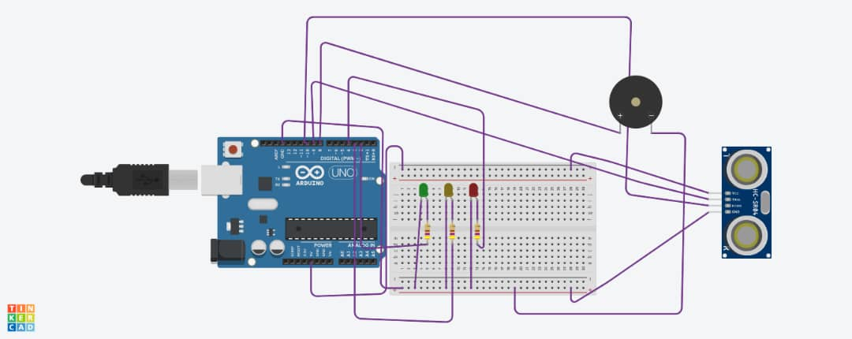

Slide 8
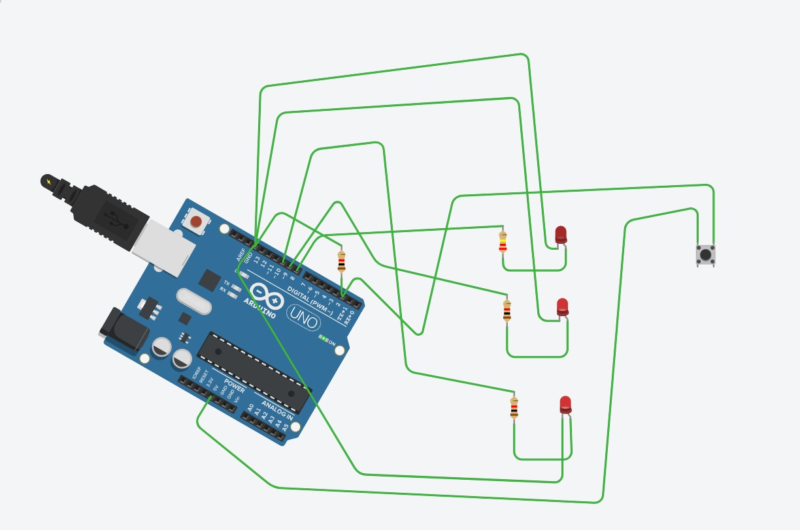

Slide 9
THANK YOU
Modern Portfolio Presentation

